Slide 1
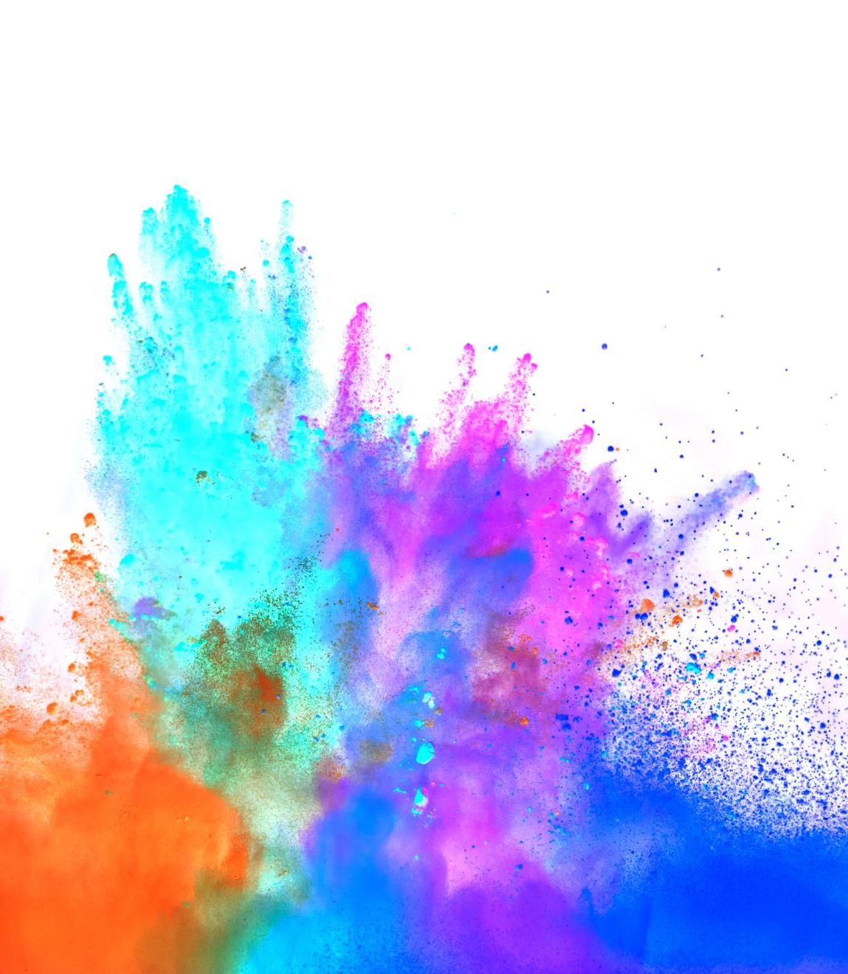
THANK YOU FOR BEING COOL An exploration of gratitude toward cool brands
Louisiana Tech University • Melanie Moore Koskie, William B Locander • mko010@latech.edu
Research Questions
Are people grateful for cool brands?
Does gratitude for these cool brands positively affect consumer reactions?

Slide 2
What do we mean by cool? By gratitude?
Coolness is a subjective and dynamic socially constructed positive trait attributed to cultural objects (like brands) inferred to be appropriately autonomous. (Warren and Campbell 2014)
Characteristics of brand coolness (Warren et al., 2019)
Original, Authentic, Rebellious, Subcultural, Energetic, Extraordinary, Aesthetically Appealing, High Status, Popular, and Iconic
Brand gratitude is an appreciation and a sense of goodwill toward a brand that motivates the consumer to act in a way that benefits the brand. (adapted Fitzgerald, 1998)
Essential elements of the emotion of gratitude (Roberts, 2004)
Benefactor (cool brand), Beneficiary (consumer), Benefit (cool brand characteristic)

Slide 3
What we know
Positive consumer outcomes are associated with both brand coolness (Warren et al. 2019) and gratitude (Palmatier et al. 2009)
The indirect effect of gratitude on positive consumer outcomes has been demonstrated in a number of contexts:
frontline employees (Bock, Folse, and Black, 2016), relationship marketing initiatives (Palmatier et al., 2009), loyalty programs (Steinhoff and Palmatier, 2016), CSR initiatives (Romani, Grappi, and Bagozzi, 2013), marketing communications (Bridger and Wood, 2017), B2B services (Pelser et al., 2015), sales (Oakley et al., 2021) etc.

Slide 4
What we expect
Hypotheses:
H1: Gratitude will indirectly affect the relationship between each brand coolness characteristic (BCC) and positive word of mouth (WOM).
H2: Each BCC will be positively related to gratitude.
H3: For each BCC, gratitude will be positively related to WOM.
Gratitude
Extraordinary
Word of Mouth

Slide 5
Methodology
Survey of 350 consumers ages 18-40 nominated a brand they think is cool.
A CFA with all study variables demonstrated adequate fit: X² = 1372.67, df = 741, p < .001, CFI = .934, RMSEA = .05, SRMR = .04
* Authentic and original did not demonstrate discriminant validity. They are collapsed in the analysis and referred to as autonomy, in line with warren et al. 2019.
Emotional
Brand
Attachment
We tested and compared the two models in SPSS using PROCESS. (Romani, Grappi, Bagozzi 2013)
We assessed gratitude along with emotional brand attachment for each of the nine characteristics.
Extraordinary
Word of Mouth
Gratitude
Controls
Age
Gender

Slide 6
What we know now
H1: Gratitude will indirectly affect the relationship between each BCC and WOM.
In each case it significantly added to the model with emotional brand attachment as a parallel mediator.
The indirect effect of gratitude ranged from .03 for rebellious, to .17 for autonomy (original and authentic).
H2: Each BCC will be positively related to gratitude.
The direct effect of BCCs on gratitude ranged from .21 for rebellious, to .71 for autonomy. Medium effect sizes were also found for aesthetically appealing, .58, and extraordinary, .59.
H3: For each BCC, gratitude will be positively related to WOM.
The direct effect of gratitude on WOM ranged from .23 for extraordinary to .36 for rebellious, subcultural, and high status. In addition, the effect sizes for gratitude on WOM were over twice as large as those of emotional brand attachment on WOM.

Slide 7
What we still don’t know
What specific benefits do consumers perceive from the consumption of cool brands?
What value is derived from the consumption of cool brands?
How are these related to brand gratitude?
What are the underlying psychological mechanisms responsible for creating gratitude for cool brands?
What outcomes are strongest for gratitude and under what conditions can managers leverage cool brand gratitude to increase that behavior?

